Slide 1

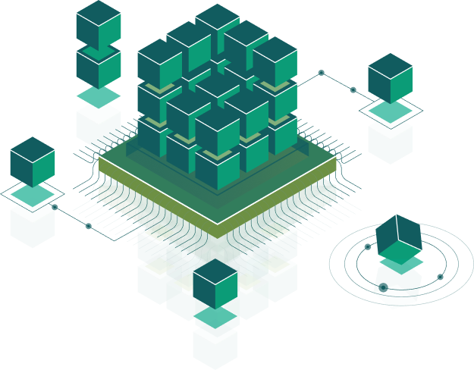
ANGULAR
Speaker:
Taras Aftanashchuk
Notes:
Introduce course and speacers

Slide 2
Dependency injection
dependency tree
Modules
Components, Directives
Lifecycle
Input
Output
HostListener
HostBinding
Pipes
Services
How works DI (@Injectable)
Singleton
Routing
Activated route
lazy loading
guards
DI Example
Patterns
Notes:
micrisoft team work

Slide 3

Thank you!

